Slide 1
IMHuS: Intelligent Multi-Human Simulator
Artificial intelligence for social robots interacting with humans in the real world
27 oct 2022 Kyoto (Japan)
Olivier Hauterville, Camino Fernández, Phani Teja Singamaneni, Anthony Favier, Vicente Matellán, Rachid Alami
RIS (Robotics and InteractionS) Group – LAAS (CNRS)
Notes:
Hi everyone, and thank you for watching this video in which I am going to present IMHuS, an intelligent multi-human simulator that has been developed at the Robotics and Interactions Group at LAAS-CNRS in Toulouse, France.

Slide 2
Motivation
Social robotics need experimentation
Experimentation needs replicability
Experimentation needs humans
Replicability is achieved by simulation
Simulations need reactive human behavior
Notes:
As roboticists, we work everyday with robotic platforms both in the real world and in simulated environments.
Our goal is to experiment how our cognitive architectures perform when they are deployed in different robots and in different scenarios.
But experimentation requires replicability and when it comes to social robotics, the presence of humans in these environments becomes a vital issue for testing the social behavior of the robots that we program.
The problem is that we can not have perfect replicability when humans are involved because if they follow exactly the same set of actions then their behavior is not human.
To act like humans, the simulated agents have to exhibit reactive behavior.

Slide 3
IMHuS – Intelligent Multi-Human Simulator
IMHuS simulates interactive agents that can be perceived by a robot in a robotic simulator
Agents exhibit social behavior in human group movement
Humans are choreographed to create high-level social behaviors
Goal: To provide metrics to evaluate a robot’s performance in social situations
Notes:
Our proposal is to provide interactive agents in a simulated environment that can be perceived by the robot to be tested in that simulation, and at the same time can perceive the robot and react to its behavior, for instance, avoiding collision or responding to its requests.
Our system is called IMHuS and provides a simple way to choreograph individual or group human behaviors through an XML configuration file.
Each configuration file describes a high-level social situation in terms of steps.
These scenarios can be used to obtain metrics to evaluate the performance of any robot.

Slide 4
Step-based social simulation
Notes:
This slide shows a graphic example of a social situation. At the beginning there are four humans, three of them are part of a group. The situation describes the individual and group movements of these humans in each step until the final situation specified in the last step is reached.

Slide 5
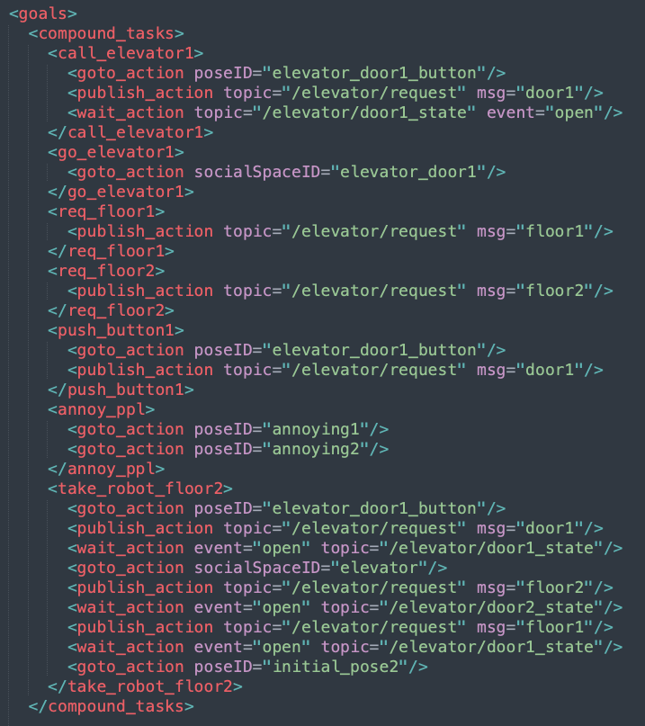
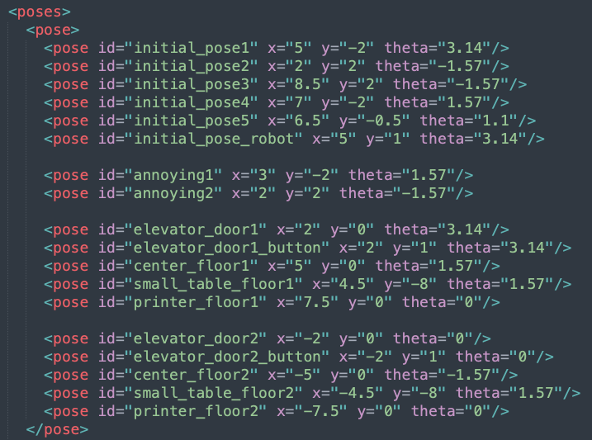
XML IMHuS Configuration File
Notes:
Just to get a glimpse of the XML configuration file, we show the main parts that it includes, which are:
the map, in this case the high-level action would be to take the elevator, the agents, five humans are involved and a tiago robot would be the one to be tested, and groups of humans. The tested robot, tiago, is not choreographed but it is declared in the configuration file because the humans can communicate asynchronously with it and respond to its requests, in this case, pressing the elevator button.
The poses, that is, specific locations on the map that are named so that they can be used in the rest of the file.
The goals, specified in terms of high-level tasks such as call the elevator or take the tested robot to the second floor

Slide 6
IMHuS – Intelligent Multi-Human Simulator
Notes:
- This is a schema to show the whole IMHuS system. At the top part we have the application layer where the XML configuration file is the input of the system specifying, as we saw in the previous slide, the map, the agents, the tasks and the scenario.
- In the center of the image, the IMHuS system interprets the information contained in the configuration file and builds the simulation,
- in this case on Gazebo, as shown at the bottom.
- The tested robot would share the scenario with the choreographed humans as shown in the following video

Slide 7
IMHuS Demo
Notes:
The scenario shows the elevator in the center with two doors that are used to simulate the first floor in the right, and the second floor in the left.
The behavior of the human agents is choreographed as follows.
At the beginning there are four humans in the first floor and two in the second floor.
Next, the two ones on the second floor take the elevator to get to the first floor.
Meanwhile, three humans go and wait for the elevator to arrive to get to the second floor. The fourth one stays next to the elevator buttons.
During this first part of the video, the tiago robot has its own goal, which is to get to the second floor, so it has to approach the elevator, wait for the door to open and get inside. Ans it has to do all these things avoiding collision with the choreographed human agents.
Once they get to specific positions in the second floor, one agent returns to the first floor.
The tiago robot takes the elevator with this human to get to its initial position.
The video shows how the choreographed human agents react to the presence of the tested robot and do not collide with it.

Slide 8
IMHuS https://github.com/LAAS-HRI/IMHuS RIS Group - Robotics and InteractionS LAAS-CNRS Toulouse, France
Olivier.Hauterville@laas.fr
phani-teja.singamaneni@laas.fr
anthony.favier@laas.fr
Rachid.Alami@laas.fr
camino.fernandez@unileon.es
vicente.matellan@unileon.es
Notes:
You can follow IMHuS development in the repository shown in this slide, and you can contact the authors of this work through their emails addresses or through links of the RIS-Group at the LAAS-CNRS and the Robotics Group at University of León.
We invite you to start using IMHuS!
Thank you for watching the video.

